Slide 1
"Digital Media Primer" Yue-Ling Wong,
Copyright (c)2013 by Pearson Education, Inc. All rights reserved.

Slide 2
Chapter 5
Capturing and Editing Digital Audio
Part 3
Multitrack Basics

Slide 3
In this lecture, you will learn:
the common workspace for multitrack editing
how to place clips on a track
how to apply effects to a track

Slide 4
Basic Steps of Working with a Multitrack Session
Place clips on tracks
Apply effects; adjust volume and pan, if needed
Mix down the tracks and export the final audio

Slide 5
Example Multitrack Application Programs
Adobe Audition Multitrack View
Apple GarageBand
Audacity
Sony ACID Pro

Slide 6
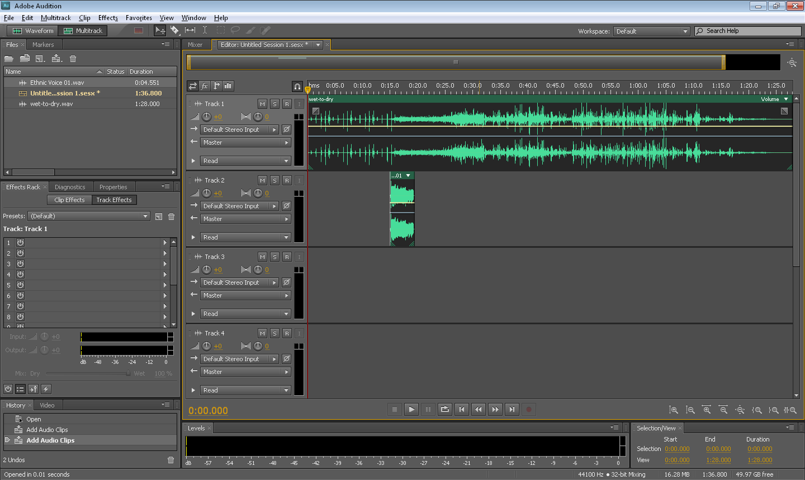
Audition:
To Place a Clip on a Track
Drag a audio clip onto a track
tracks

Slide 7
GarageBand:
To Place a Clip on a Track
Drag a audio clip (from A) onto the Track window (B)
Track window
A new track will appear when you drag a clip to here

Slide 8
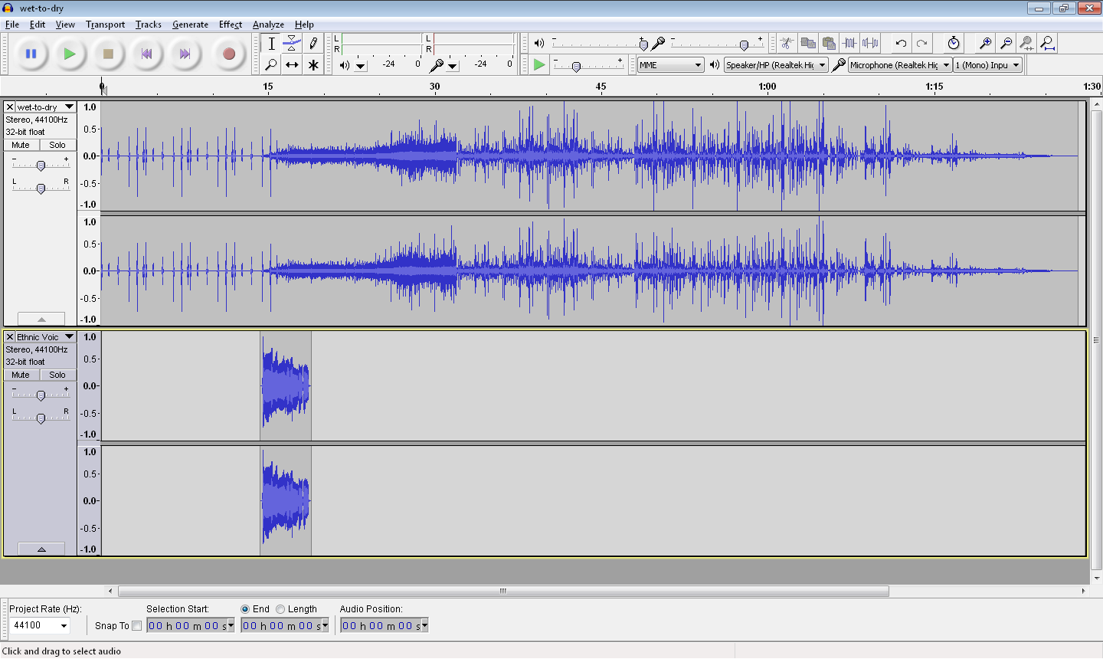
Audacity:
To Place a Clip on a Track
Importing an audio file will add it to a new track
tracks

Slide 9
To Move a Clip to Another Time on the Track
Audition:
Use the Move tool click and drag the clip
GarageBand:
Click and drag the clip
Audacity:
Use the Time Shift tool, click and drag the clip

Slide 10
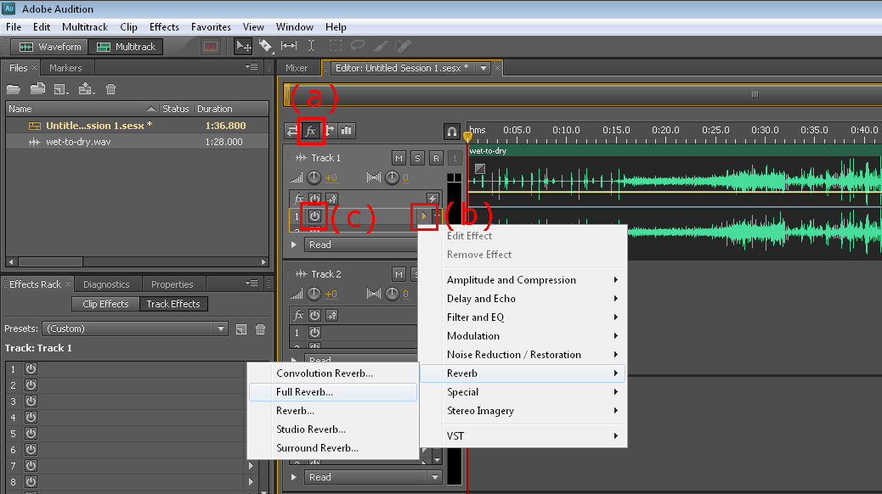
Audition:
Applying Effects to a Track
Step 2: Select an effect
Step 1: Turn on Effect (fx)
The effect can be toggled on and off

Slide 11
GarageBand:
Applying Effects to a Track
Step 2: Click on a slot in the Effects section
Step 1: Select a track
Step 3: Click on the button to adjust the parameters for the effect

Slide 12
Audacity:
Applying Effects to a Track
Select the whole track or part of the clip
Choose an effect from the Effect menu

